Slide 1
EDA Assignment – Aryama Ray
UBER Supply Demand Gap Analysis

Slide 2
Abstract
Uber Supply Demand gap analysis has been performed in order to identify root cause of the problem viz. Airport to City commute and vice versa.
The analysis has been done based on masked data for 5 consecutive weekdays from UBER.
We have performed Data Cleaning and EDA processing to analyze and forecast the trend during weekdays.
Due to masked data, for a given driver consecutive UBER cab requests and corresponding status is not available. Hence we did not incorporate waiting time to analyze the current problem.
We have identified Request for Cab from City to Airport gets higher during early morning to late morning slot, whereas Request for Cab from Airport to City gets higher during evening to night time, which is predominantly due the flight timings.
Two major issues were identified. First, for City to Airport commute, drivers usually cancel cab request during early morning time. Second, for Airport to City commute, users face unavailability of cab issue mostly during evening time.

Slide 3
Assumptions and Flow of Analysis
Cab requests with status ‘Trip Completed’ are having both request time and drop time. Drop times for the Cab requests with status ‘Cancelled’ and ‘No Cars Available’ are not available.
For each completed request, data for route distance is not available, hence analysis based on time to complete a trip is considered as out of scope.
Analysis is performed based on Cab request time and status of the trips. So, drop times with NA values were not taken into account.
First phase of analysis is performed to identify most pressing problem on Airport to City ,to and fro commute using Uber cab service.
It is observed that cab request and request status pattern is similar throughout week. Based on cab request frequency throughout the day , hours of the day is segmented into six time-slots.
Second phase of analysis is performed based on the cab request frequency in segmented time slots.
Performed Supply and demand gap analysis on the percentage ratio of completed trip and the total trip request.

Slide 4
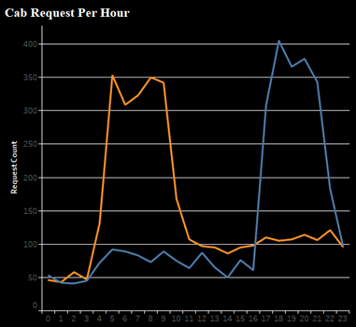
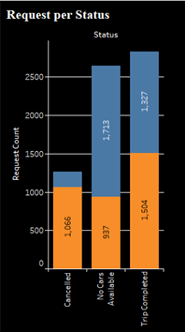

Analysis of Most Pressing Problem
We observed that cab request frequency gets higher in the early morning time(5am to 10am) from City to Airport commute and the same gets higher in the evening (around 5pm to 10pm) from Airport to City.
Request frequency per status plot tells us that for City to Airport commute ‘Cancelled 'cab request is an issue whereas for Airport to City Commute, ‘No cabs available’ is a major issue.

Slide 5
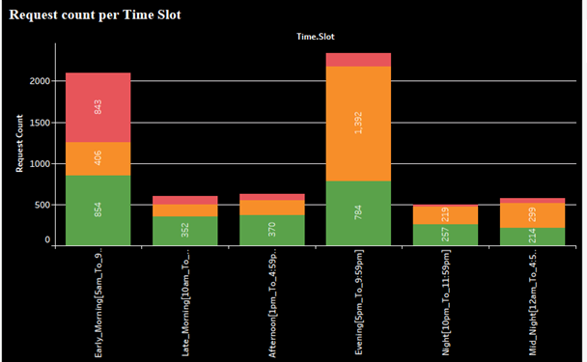

Analysis of Most Pressing Problem(contd..)
We have segregated whole day into six timeslot based on cab request frequency.
It is observed that cab is not available mostly during evening timeslot and drivers used to cancel cab request mostly during early morning time.
No car is available during Evening
Most requests get cancelled during Early Morning

Slide 6
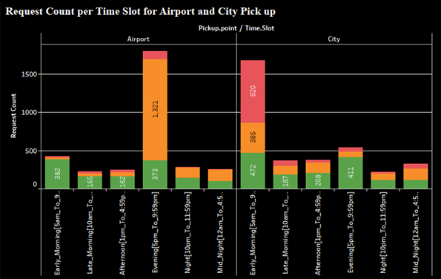

Analysis of Most Pressing Problem(contd..)
We have drilled down cab request frequency per time slot further based on pick up point.
It is identified that car availability issue during Evening time slot happens for Airport to City commute. Also, cab request cancellation issue during Early morning timeslot happens mostly for City to Airport commute.

Slide 7
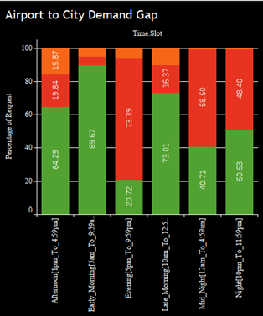
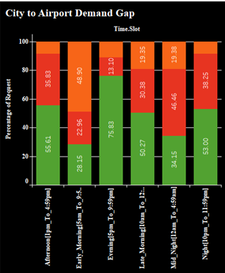

Supply Demand Gap Analysis
We have considered Trip completed status as the Supply and all type of requests from customers as Demand.
It is inferred that Airport to City commute supply-demand gap is higher during Evening Time slot[5pm-before 10pm] and for City to Airport gap is higher during Early Morning Time slot[5am to before 10am].
supply demand gap is higher during Evening Time slot[5pm-before 10pm]. Only 20.72% of demand is supplied.
Supply-demand gap = Trip Completed – ( No cars available + Cancelled )
supply demand gap is higher during Early Morning Time slot[5am-before 10am]. Only 28.15% of demand is supplied.

Slide 8
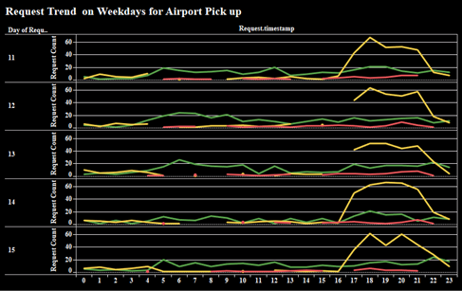
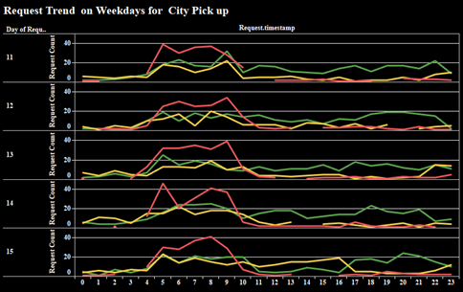

Root Cause Analysis for Supply- Demand gap
Wide Demand gap issue for Airport to City commute during Evening Time slot[5pm-before 10pm] is mostly due to car unavailability.
Wide Demand gap issue for City to Airport during Early Morning Time slot[5am to before 10am] is mostly due to Cancellation request.
This trend is similar throughout the weekdays. This observance is based on the masked weeks data from UBER.

Slide 9
Recommendation for the Issue
Airport
Increase Cab availability during Evening timeslot - 5pm to 10pm at Airport.
City
Initiate dedicated City to Airport Cab service during Early Morning timeslot – 5am to 10 am.
Recommend Incentive amount based on the waiting time at Airport during Evening Timeslot for Airport to City.
Recommend Penalty charges after certain number of cancellation to the driver during Early Morning Timeslot for City to Airport.

